Slide 1
Identifying vital nodes based on Collective Influence and Improved Reinsertion
Solution for Datacastle Master Competition
TeamID: zhfkt
Fengkuangtian Zhu

Slide 2
Datacastle Master Competition Task
The target of Competition is to give a ranking list of nodes according to their importance. The top-ranked nodes will have more importance.
We can remove the nodes from the top-ranked ones in the ranking list and calculate the size of giant component after each removal, which will break down the network into many disconnected pieces.
Therefore, the better algorithm, the sooner the network will collapse to the zero giant component with smaller count of provided nodes.

Slide 3
Collective Influence
Morone F, Makse H A. Influence maximization in complex networks through optimal percolation[J]. Nature, 2015, 524(7563): 65-U122.
Morone F, Min B, Bo L, et al. Collective Influence Algorithm to find influencers via optimal percolation in massively large social media[J]. Scientific reports, 2016, 6.

Slide 4

Collective Influence
Collective Influence (CI) algorithm using optimal percolation for localizing the minimal number of influential nodes.
The problem of finding the minimal set of influencers can be mapped to the optimal percolation. CI will calculate the value of each node in the following Formula and remove the highest value of nodes.

Slide 5
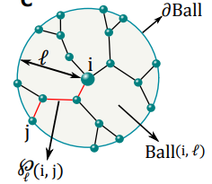
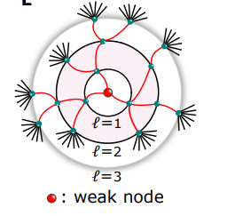
Collective Influence

Slide 6
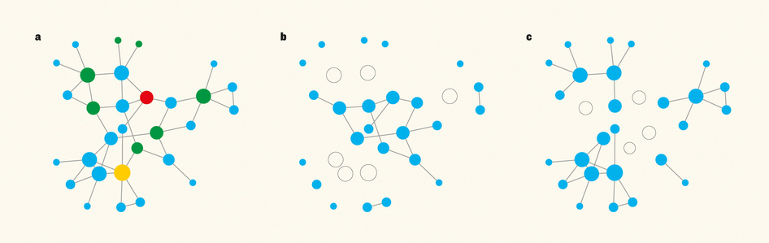
Collective Influence
A) Removing the nodes with the largest collective influence (the influencers) allows for efficient dismantling of networks.
B) removing 6 nodes with the highest degree leaves the network mostly intact
C) removing 4 top influencers leaves subgraphs that are smaller.

Slide 7
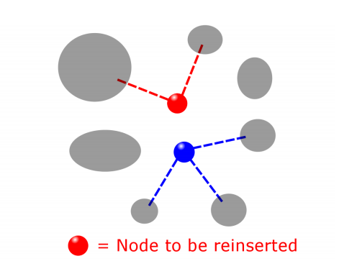
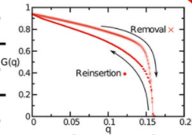
Reinsertion
Reinsertion adds back one of the removed nodes, which is chosen such that, if once rein-
serted, it joins the smallest number of clusters. When the node is reinserted reinsertion
also restores the edges with its neighbors which are in the network (but not the ones with
neighbors not yet reinserted, if any). The procedure is repeated until all the nodes are
back in the network.

Slide 8
New Improved Reinsertion
The new improved reinsertion joins clusters of smallest sizes instead of the smallest number of clusters
Use Disjoint-Set to improve the performance

Slide 9

Experiment on DataCastle Master Competition
Datasets are all verified on the default 4-core CPU machine (Intel Xeon E5-667v4 Broadwell 3.2 GHz) in 8G memory

Slide 10
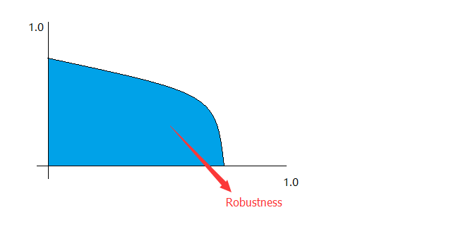
Robustness
Robustness is introduced in the Competition to quantify the performance of ranking nodes methods.
C. M. Schneider, A. A. Moreira, J. S. Andrade, S. Havlin, and H. J. Herrmann. Mitigation of malicious attacks on networks. Proceedings of the National Academy of Sciences, 108(10):3838 - 3841, 2011.

Slide 11
Result
Collective Influence without Reinsertion (l=2)
Collective Influence with Reinsertion (l=2)
Collective Influence with New Improved Reinsertion (l=0)

Slide 12
Reinsertion can improve the Robustness

Slide 13
New Improved Reinsertion is better than Original Reinsertion
Collective Influence with Original Reinsertion (l=2)
Collective Influence with New Improved Reinsertion (l=0)
New Improved Reinsertion can get better result in terms of speed and robustness, even when l = 0 (degenerate to Degree)

Slide 14
Compare with other methods
Closeness : Robustness 2.8801 , 592034 Seconds ( ~7 days, 1 week)
Betweenness : Robustness 1.606 , 2062513 Seconds ( ~24 days )
PageRank: Robustness 1.436 , 8221 Seconds
Degree (HDA): Robustness 1.2638 , 20 seconds
Collective Influence with original Reinsertion (l=2): Robustness 1.0701 , 43181 seconds
Collective Influence with new improved Reinsertion (l=0, degenerate to HDA): Robustness 1.0403 , 211 seconds.

Slide 15
Best Result using Collective Influence and Improved Reinsertion
Best Result: Robustness 0.9929 , 10172 seconds.
mainly applying more strict internal parameters
the other technique details are described in the solution papar

Slide 16
Compare with other methods

Slide 17
Conslusion
Compared with traditional algorithms including Betweenness, Closeness, PageRank, Degree and Collective Influence, the new proposed algorithm of new improved reinsertion to find most influential nodes is able to achieve the better performance on the 8 competition datasets in terms of robustness and speed.
The robustness of Collective Influence without Reinsertion is even worse than Degree (HDA).

Slide 18
Open Source in Github
Code: https://github.com/zhfkt/ComplexCi
Solution Paper: https://github.com/zhfkt/ComplexCi/releases/download/v0.11/Fengkuangtian.Zhu.-.teamID.zhfkt.-.Reconstructing.collapsed.complex.network.to.find.most.influential.nodes.pdf
Email: zhfkt@hotmail.com
weibo: zhfkt
Thank you !

